Slide 1


Individual Project: Integration of an Amarisoft 5G Base Station and the 5G Core Implementation Free5GC
Submitted by: Kumar Satyam
First examiner: Prof. Dr.- Ing. Ulrich Trick
Date of start: August 14, 2023
Date of submission: February 15, 2024

Slide 2
Contents
Introduction
Target States
Realisation
Summary
References

Slide 3

Introduction
Free5GC: free5gc is an open-source project for developing a 5G core network (5GC) software.
The project aim is to implement the 5G core network defined in 3GPP Release 15 (R 15) and beyond, which is focusing on the 5G NGAP protocol, NAS encryption, integrity protection algorithms, and authentication features.
This software is developed using C and Golang
Various NFs like AMF, SMF, UPF, and more to ensure a complete 5G network infrastructure.
The source code for Free5GC can be freely downloaded from the official website or GitHub repository for installation and deployment.
Notes:
Free5GC is an open-source project dedicated to developing software for a 5G core network (5GC). The project's goal is to implement the 5G core network as defined in the 3GPP Release 15 (R15) and beyond. It focuses on the 5G NGAP protocol, NAS encryption, integrity protection algorithms, and authentication features.
This software is developed using C and Golang, incorporating various Network Functions (NFs) such as AMF, SMF, UPF, and others, to ensure a comprehensive 5G network infrastructure. The source code for Free5GC is available for free download from the official website or the GitHub repository, facilitating easy installation and deployment.

Slide 4

Amarisoft Amari Callbox Classic: It is a part of the AMARI Callbox series and is designed as a compact and versatile solution for testing various 5G and LTE scenarios.
It acts as a 3GPP-compliant gNB and 5GC, providing functional and performance testing capabilities for a range of devices including 5G NSA and SA, LTE.
This software is highly optimized and offers functionalities like logging and measurement tools, automatic test setup and scripting through a WebSocket API, and easy configuration using JSON files.
Amari Callbox Classic

Slide 5
Target State
All the network elements of 5GC such as AMF, SMF, UPF, AUSF are software-defined and hosted inside the Callbox PC. The network functionality of gNB is also available in the same Callbox PC.
Core Network Database: The core network maintains a persistent database that records all the parameters associated with the configured User Equipments (UEs).
UE Compatibility: The commercial User Equipments utilized, such as 5G-enabled cell phones, must be compatible with the n77 or n78 NR (New Radio) frequency bands.
Frequency Range Requirement: Specifically, the UEs should support the frequency range of 3.7 to 3.8 GHz for optimal compatibility and performance.
When the 5G environment runs, the connection between the AMF of 5GC and the gNB should be established using the NGAP signaling.
Notes:
the commercial UEs we use, particularly the 5G cell phones, align with specific frequency bands to ensure seamless integration with our network. These devices should be compatible with the n77 or n78 New Radio, or NR, frequency bands. This is a crucial factor in achieving the desired network performance.
Within these NR frequency bands, the 3.7 to 3.8 GHz range. This particular frequency range is essential for us because it's where our UEs are expected to operate optimally. To ensure that our device can support this range full potential of our network.
The sequence kicks off with the AMF within the 5G Core, reaching out to the gNB through NGAP signaling. This is a crucial handshake that sets the stage for the subsequent establishment of an SCTP connection between the two entities.

Slide 6
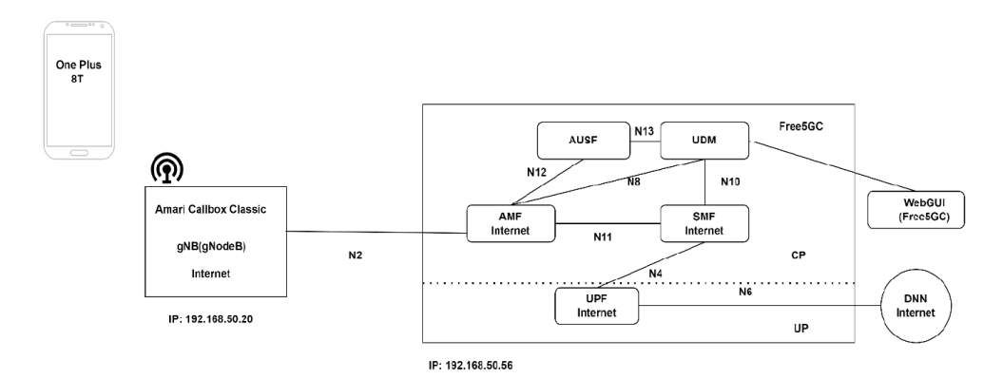

Slide 7
Afterward, the SCTP connection shall be established between the 5GC and gNB.
When UEs are turned on and kept within a few meters range (not more than 10 meters) from the gNB’s antennas, they shall start scanning the compatible NR bandwidth.
Once the UEs detect the gNB signals, the initial PRACH signals alongside the registration request from the UEs shall be transmitted to the base station or gNB.
the UEs shall be able to connect with the simulated 5G core network. The 5G core network contains the persistent UE database, which stores all the data and parameters of the configured UEs.
Once the initial connection is established successfully, then the UEs shall connect to the 5G and get the IP addresses allocated, after which each UE shall display the 5G signal icon and “connected” status.
Uses cases: Implementation and testing Free5GC and Amari Callbox Classic gNB.
Notes:
As we power on our User Equipments, or UEs, ensuring they are within a 10-meter radius of the gNB's antennas, they commence a scan for compatible NR bandwidths. It's during this scan that the gNB's signal comes on their radar, prompting them to send initial PRACH signals coupled with a registration request back to our base station.
The purpose of this prototype is to integrate and meticulously evaluate the performance of the Free5gc and the gNB to ensure that they work efficiently, with the project goal.
The software elements of Free5gc and Amari callbox classic “gNB” 5G base station are setup and exam-ined in a standalone mode (SA).
Testing of software-defined network elements of 5GC i.e., AMF, SMF, UPF, AUSF, UDM, with the gNB to check whether they are communicating or not

Slide 8
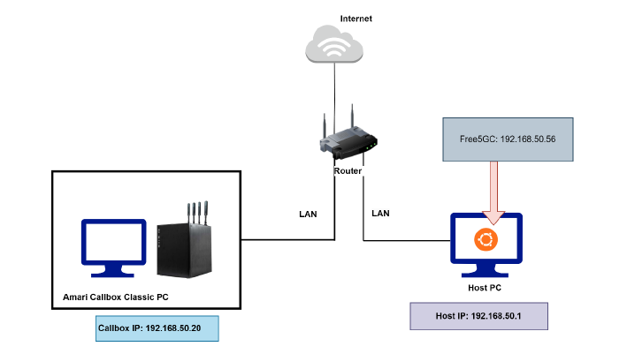
Realisation
This section showcases the configuration and detailed process of establishing an advanced 5G standalone network using the capabilities of the Callbox Classic with Free5GC v 3.3.0.
Setup of 5G standalone environment.
Notes:
Setup of 5G standalone: To fulfill the objectives, another PC “Host PC” is connected to the Amari callbox PC. The host PC is used to install and configure Free5GC software under the research study.
The host PC will enable remote connection to the Callbox component through the Secure Shell Protocol (SSH) for remote operations. In addition, the Amarisoft Web GUI is accessible via this same computer.

Slide 9
Next step is installation of Free5GC v 3.3.0, Go lang, MongoDB, amf, upf, smf, WebConsole.
Configuration on Free5GC: After launching the Free5GC VM, it needs to be configured to communicate with the Amari Callbox Classic (gNB).
The “amfcfg.yaml” file is initially configured because it communicate with gNB of Amari Callbox Classic via N2 interface. AMF (Access Mobility Management Function) which is also responsible for the management of mobility, authentication, and security.
In “amfcfg.yaml” the ngapIpList is set to 192.168.50.56 (which is the IP address of Free5GC) and ngapPort: 38412.
The PLMN as 00101 given by Amarisoft test sim card and the IMSI number was 001010123456789. The TAC is entered via the Amarisoft WebGUI for NGAP request and response i.e., 000064.
The Globally Unique AMF Identifier (GUAMI) consists of the MCC (12 bits), MNC (12 bits), and the AMF Identifier (24 bits), which is further divided into three sets: the AMF Region ID (8 bits), the AMF Set ID (10 bits), and the AMF Pointer (6 bits). This information is available in the Amarisoft WebGUI NGAP Response

Slide 10
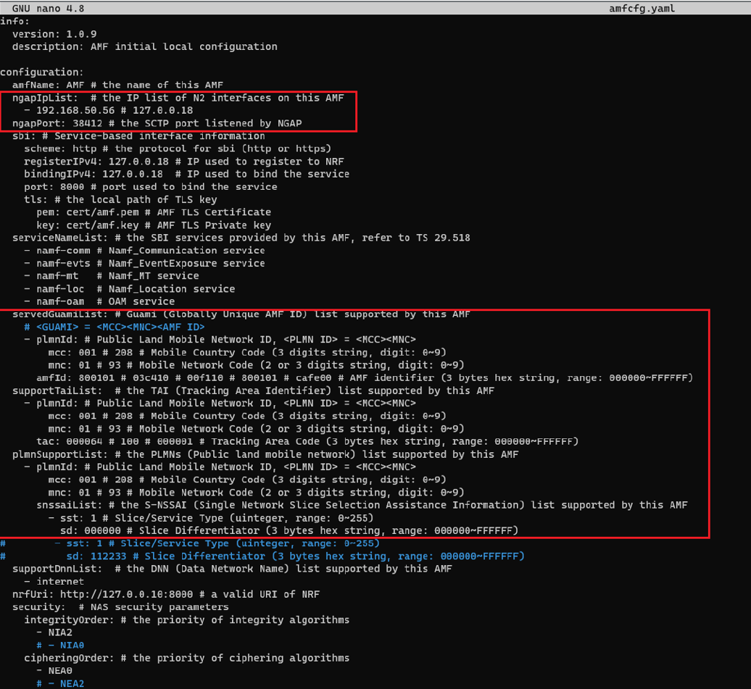

Slide 11
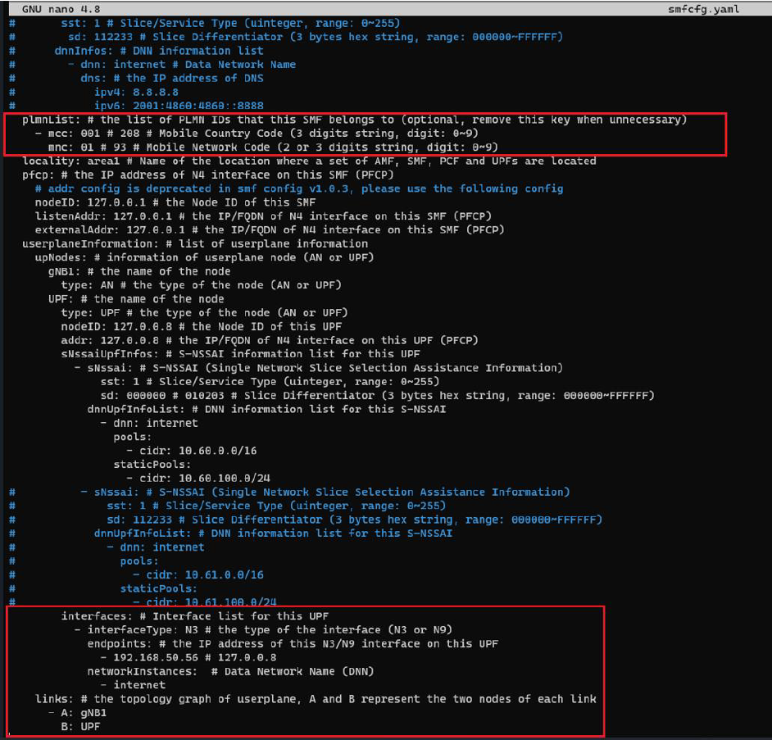
In “smfcfg.yaml” changes made in PLMN were modified to 00101 (mcc: 001 and mnc: 01) and also endpoint IP is also changed to IP address of Free5GC at N3 which works between UPF and gNB.

Slide 12
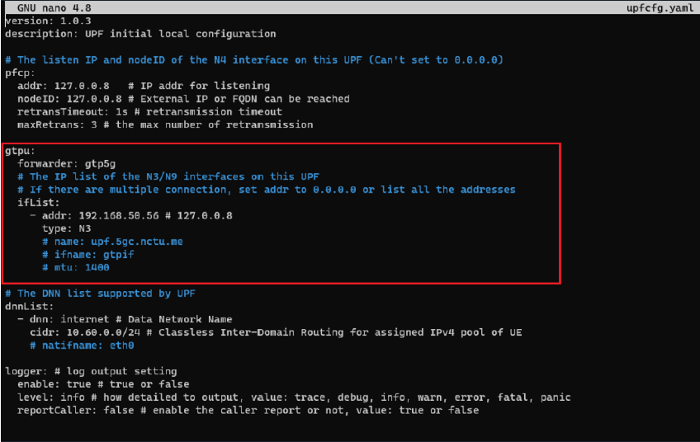
The “upfcfg.yaml” file, the IP address of Free5GC which is already mentioned. Gtpu protocol facilitates communication between the gNB of Amari and the UPF of 5G core network.

Slide 13
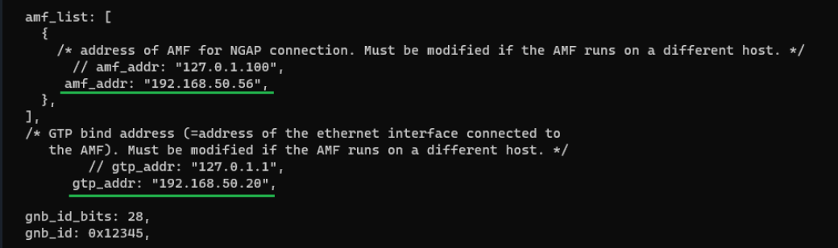
Configuration on Amari Callbox Classic:
The configuration is made in gNB “sam.enb.cfg” in amf list and gtp_addr. Here, the amf_addr: 192.168.50.56 is Free5gc IP address and gtp_addr: 192.168.50.20 is the IP address of Amaris Callbox Classic.
sam.enb.cfg

Slide 14
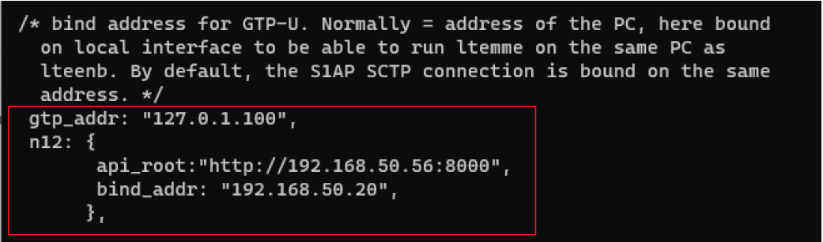
The configuration is made in mme “sam-mme.cfg” in gtp_addr using N12 interface of Free5gc ausfcfg.yaml
sam-mme.cfg (mme.cfg)

Slide 15
UE Configuration:
The smartphone which is used: One plus 8T. The following parameters need to be followed:
Go to settings/ Mobile network/select SIM 1or SIM 2 if sim is available in that slot.
Turn on Data roaming.
Go back to mobile network.
Select APN (Access point names), add the first APN with following parameter:
Name = Internet
APN = internet
MCC = 001
MNC = 01
APN type = internet, default
Save it and select it.
Reboot smartphone.
After configuring all the parameters in Free5GC and Amari callbox classic, restart both VM’s i.e., Free5GC and Amari callbox.

Slide 16
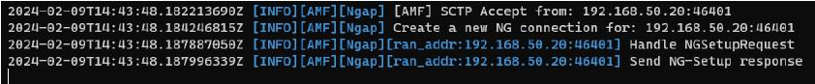
Observation:
After opening Free5GC VM via SSH: Just need to follow the commands
sudo sysctl -w net.ipv4.ip_forward=1
sudo iptables -t nat -A POSTROUTING -o enp0s3 -j MASQUERADE
sudo systemctl stop ufw
sudo iptables -I FORWARD -j ACCEPT
sudo systemctl start mongodb
After this command, build the UPF to build using “make upf”.
Execute the run script: This involves running the free5gc by using the command "./run.sh“, by running this command the logs will appear that provide details record of the operations and status message from various network function within the free5gc framework.
NGSetupRequest and Response
Notes:
sudo sysctl -w net.ipv4.ip_forward=1: This command enables IP forwarding, which is necessary for routing packets across different networks.
sudo iptables -t nat -A POSTROUTING -o enp0s3 -j MASQUERADE: This sets up a masquerade rule, which allows for Network Address Translation (NAT) on the specified network interface (enp0s3). This is often used to provide internet access to a local network.
sudo systemctl stop ufw: This stops the Uncomplicated Firewall (ufw), which is a frontend for managing iptables firewall rules.
sudo iptables -I FORWARD -j ACCEPT: This command inserts a rule into the iptables FORWARD chain to accept all forwarding traffic. This can be necessary to allow routed traffic to pass through the firewall.
sudo systemctl start mongodb: Finally, this starts the MongoDB service, which is a NoSQL database program.

Slide 17
Open the Amari Callbox Classic in another tab via SSH.:
Callbox is configured to provide an automatic LTE service. At each reboot of the PC, the LTE network is turned on automatically.
There are few commands to manage LTE automatic service.
Status: “service lte status” //this command will return “active(running)” status if service is running.
Stop: “service lte stop” // this command will stop the services.
Start: “service lte start” // this command will start the LTE service.
Disable: “sysytemctl disable lte” // LTE service remains enable until next reboot.
Enable: “sysytemctl enable lte”. // LTE service remains disable until next reboot.
Executing any of these commands will affect the Amarisoft WebGUI, which will refresh automatically.
On the Amarisoft WebGUI, NGAP request and response between AMF and gNB

Slide 18
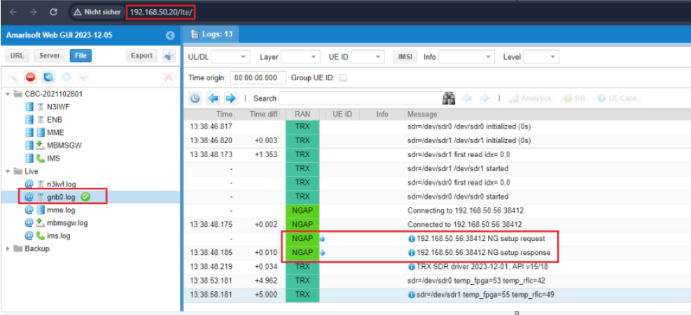
NGAP Request and Response

Slide 19
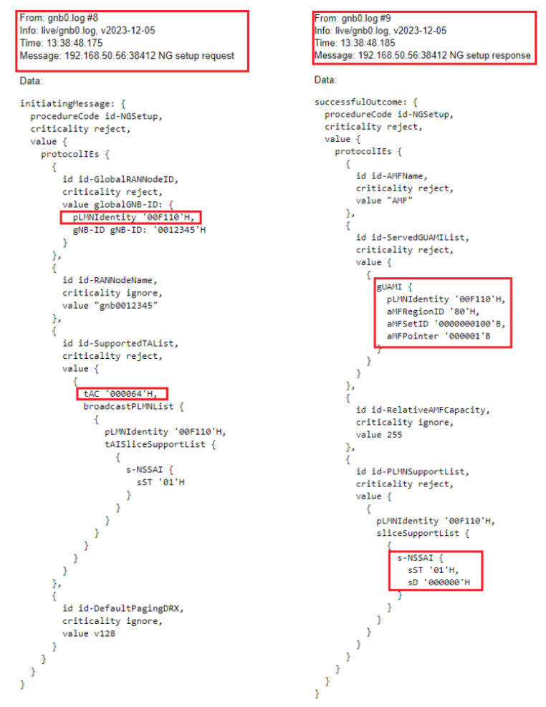
NGAP request and response on Amarisoft WebGUI logs

Slide 20
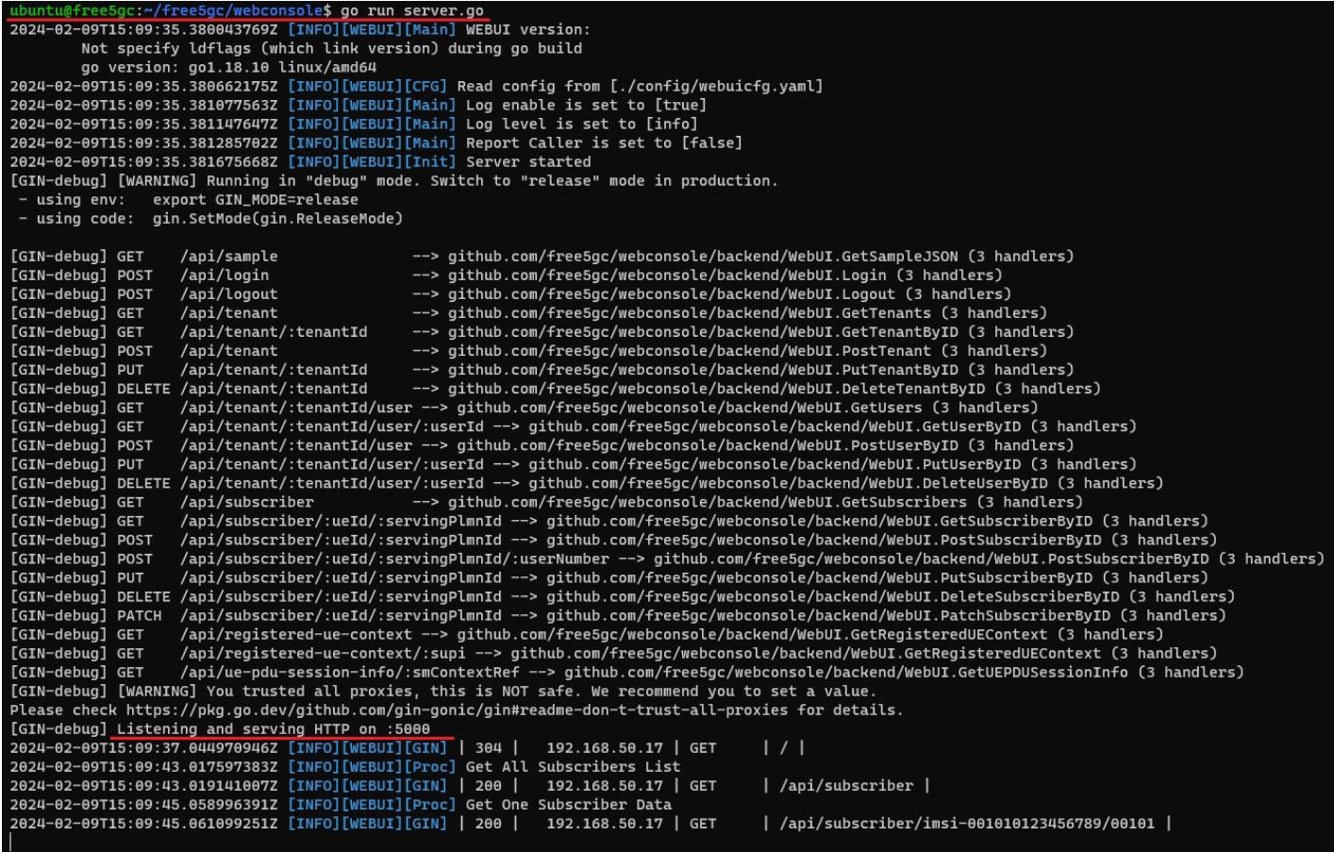
Opening Free5GC in another tab via SSH for WebGUI and for that need to run the command:
“cd ~/free5gc/webconsole”
“go run server.go”
Free5GC WenGUI

Slide 21
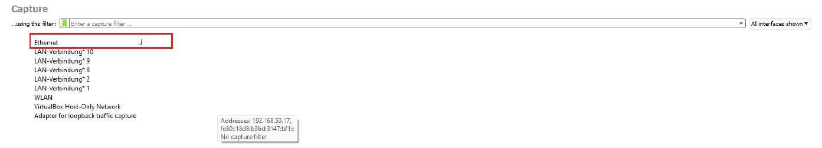
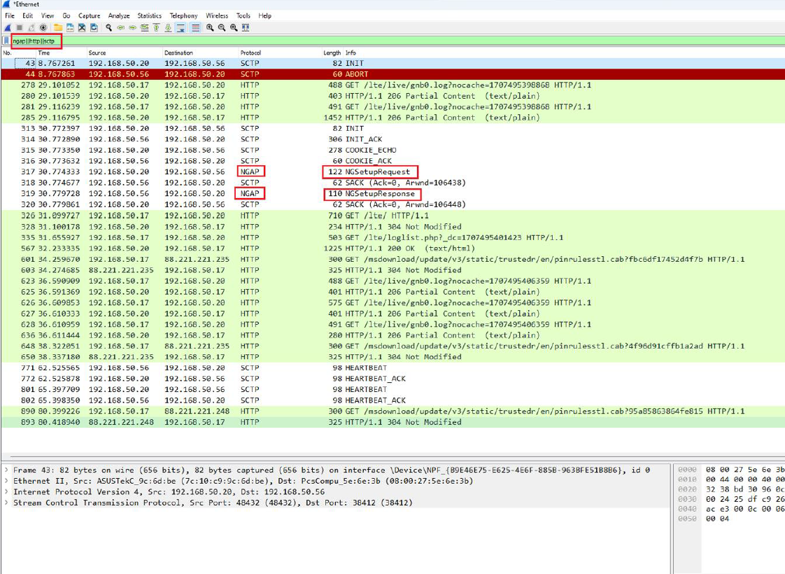
After executing all the commands together (./run.sh, go run server.go, and service lte restart on the Amari callbox), open Wireshark and select 'Ethernet'. After selecting 'Ethernet', apply the filter (ngap||http||sctp).
Wireshark & ngap||http||sctp

Slide 22
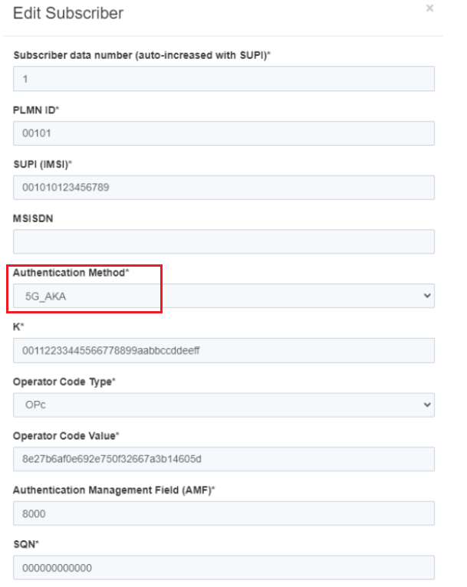
Issue during project:
In this issue, there are two types of authentication methods in Free5GC: 1) 5G_AKA, and 2) EAP_AKA_PRIME.
5G_AKA: In the Free5GC WebGUI, when editing a subscriber, if the authentication method is set to 5G_AKA and the configuration is saved, this issue occurs after re-running all the commands in Free5GC and Amarisoft. The issue arises when the smartphone is either restarted or put into airplane mode.
5G_AKA

Slide 23
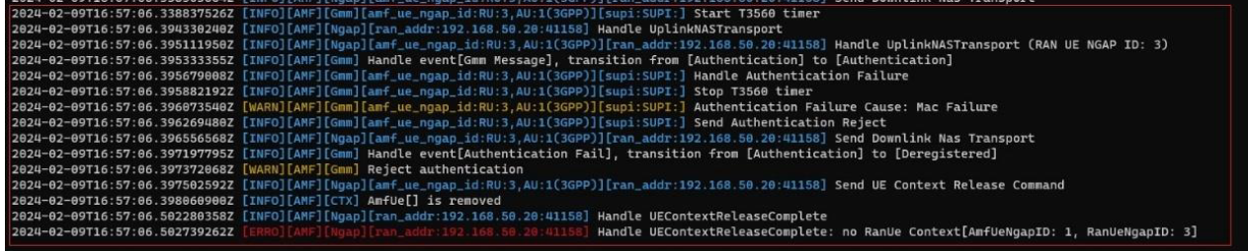
Authentication failure (MAC failure) at Free5GC

Slide 24
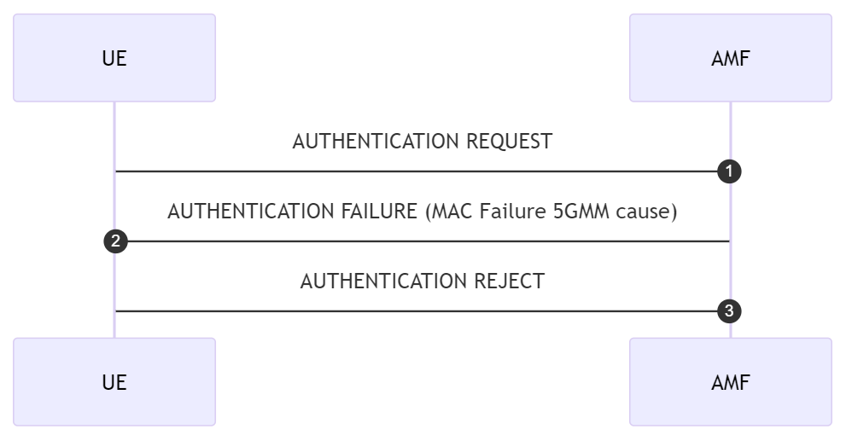
T3560
Notes:
5GMM cause" refers to the set of causes related to 5G Mobility Management (5GMM).
The cause value "#20" indicating "mac failure" is an error code that points to a mismatch in the Message Authentication Code (MAC) during a security procedure.

Slide 25
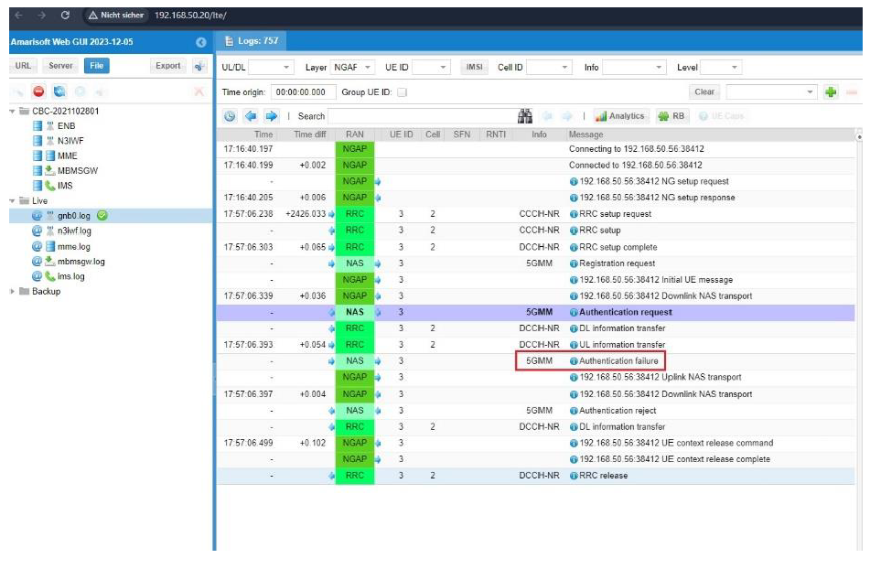
Authentication failure logs in Amarisoft WebGUI

Slide 26
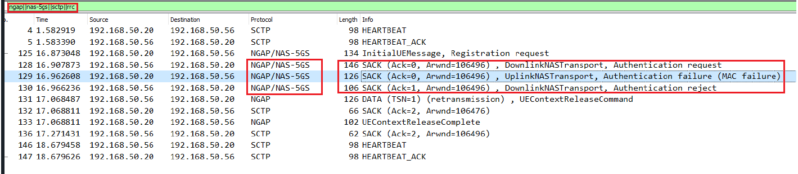
MAC failure (5G_AKA)

Slide 27
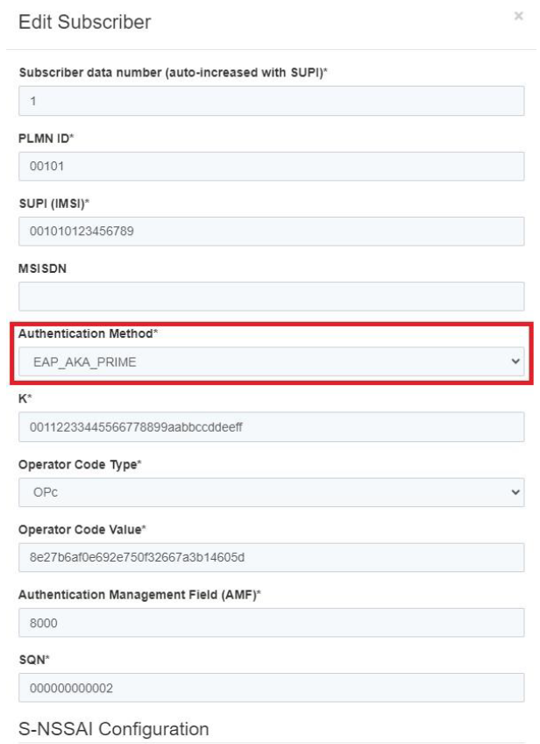
EAP_AKA_PRIME: The same approach as used in 5G_AKA should be applied, with the only modification being the authentication method, which should be changed to EAP_AKA_PRIME instead of 5G_AKA.
EAP_AKA_PRIME

Slide 28
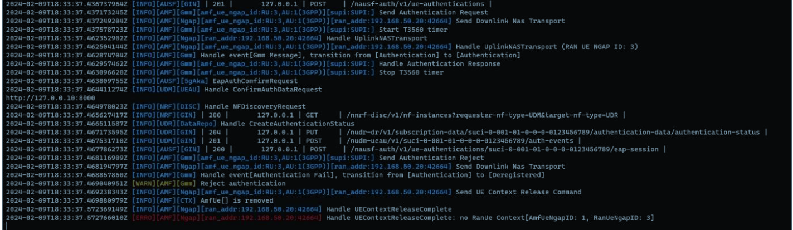
Issues occurred in Free5GC after changing Authentication method shows the Amarisoft WebGUI getting Authentication request, Authentication response and the rejection of Authentication.
Free5GC changing Authentication Method

Slide 29
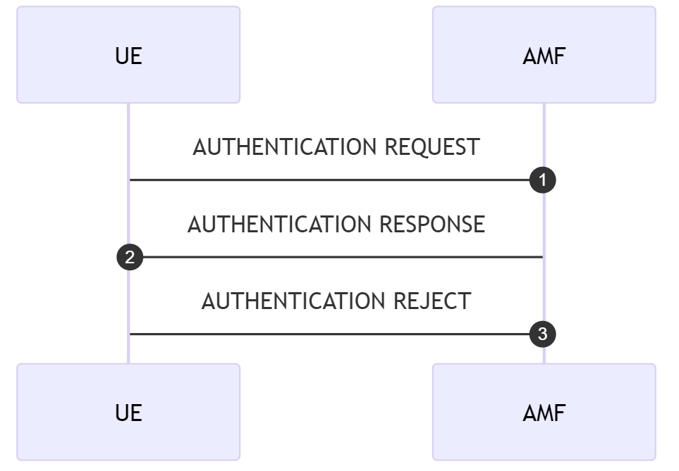
EAP_AKA_PRIME Chart

Slide 30
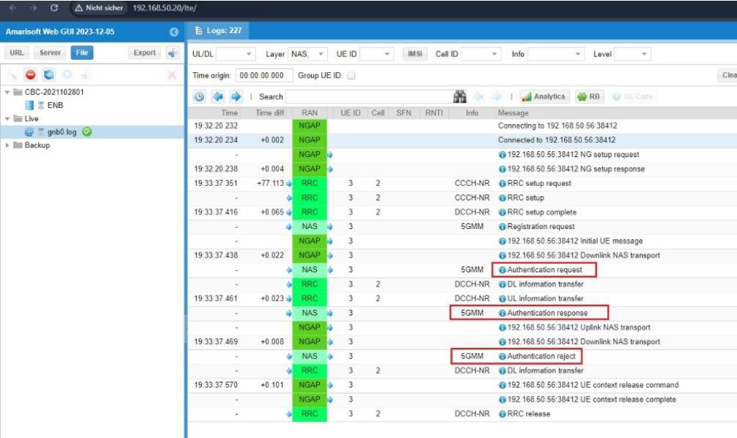
Amarisoft WebGUI Authentication request, response, reject

Slide 31
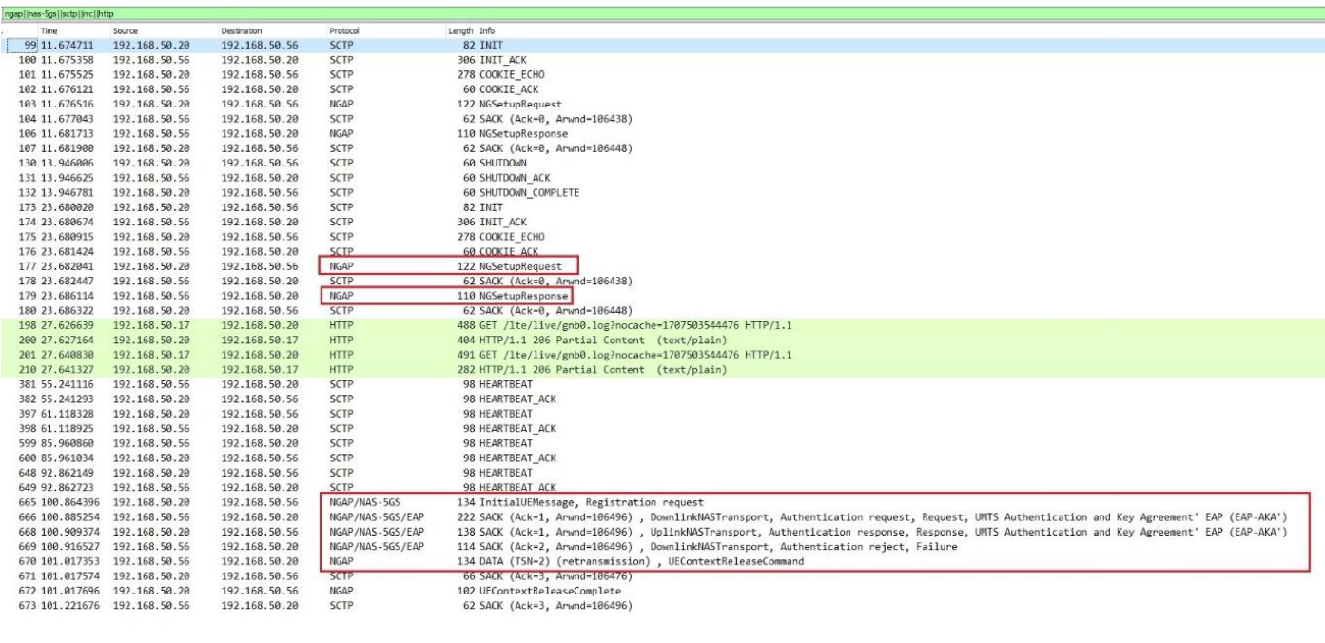
Wireshark after changing Authentication Method
Notes:
UMTS is a part of 3G.

Slide 32
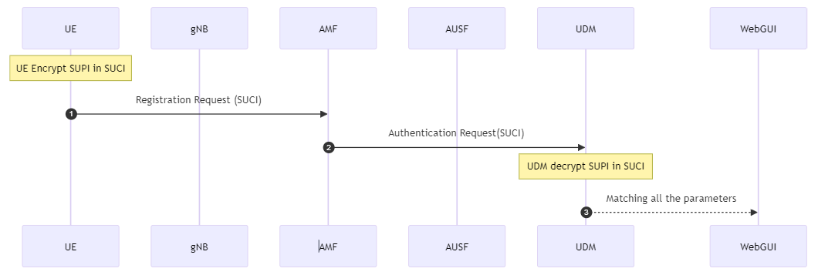
This issue occurred because the AUSF and UDM were unable to authenticate the UE. This was due to the UDM checking the data from the Free5GC WebGUI, where there was a mismatch in the values of OPC, SQN, and the Authentication Management Field (AMF).
Free5GC does not support the AMF value '9001' and the SQN value '000000000000’.

Slide 33
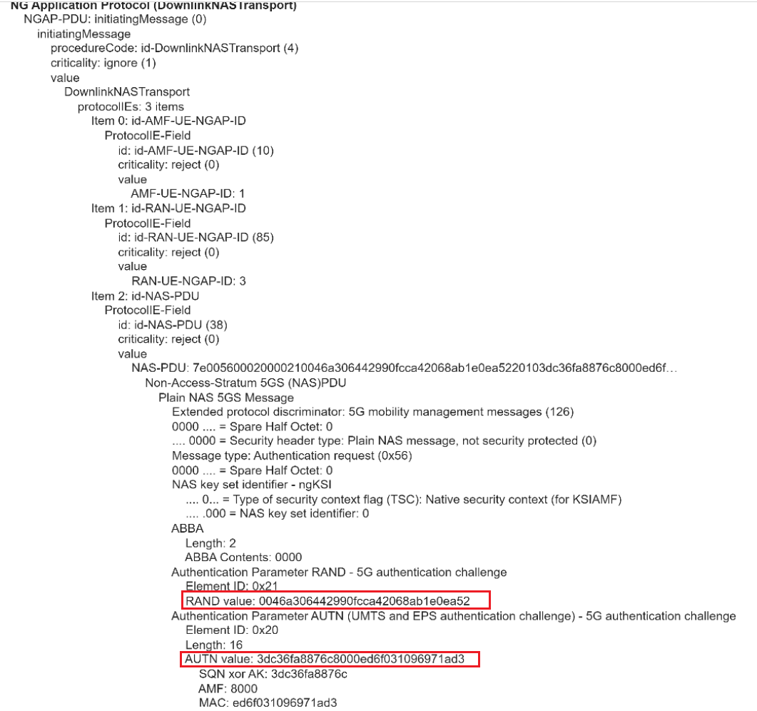
The most significant problem was that Free5GC does not support the SIM algorithm 'Milenage', whereas the Amarisoft UE supports the SIM algorithm 'XOR'. As a result of this issue, NAS authentication failed; in the NAS Authentication Request, half of the AUTN values were correct, while the other half were incorrect.
Rand and AUTN value
Notes:
RAND (Random Number):
RAND stands for Random Number. It is a value generated by the network (typically by the Authentication Center, AuC) and sent to the mobile device (User Equipment, UE) during the authentication process.
The purpose of RAND is to provide a fresh, random challenge that ensures the authentication session is unique and to prevent replay attacks.
The UE uses this RAND along with a secret key (which is known both to the SIM card in the device and the network's AuC) to compute response values that are sent back to the network for verification.
AUTN (Authentication Token):
AUTN stands for Authentication Token. It is also generated by the network and sent to the UE along with the RAND.
The AUTN is used by the UE to verify the authenticity and integrity of the RAND received from the network. It ensures that the RAND has been sent by a legitimate network and not an imposter trying to spoof the network.
The AUTN typically contains a sequence number to protect against replay attacks, and an authentication management field (AMF), which specifies how the authentication should be handled.
It also contains a Message Authentication Code (MAC) that the UE can check using its stored key to verify the authenticity of the AUTN.
During the authentication process, when the UE receives RAND and AUTN, it calculates the expected MAC based on the RAND and its stored key, and compares it with the MAC in the AUTN. If they match, it accepts the authentication token as valid. The UE also checks the sequence number within AUTN to protect against replay attacks. Then, the UE generates a response (RES), which is sent back to the network. The network then compares this RES with its expected value. If they match, the UE is successfully authenticated.

Slide 34
Summary
The project aims to integrate Amarisoft's Callbox with the Free5GC implementation to establish a fully functional 5G Standalone (SA) network. Some objectives have been successfully achieved during the project timeline.
The Access and Mobility Management Function (AMF) within Free5GC and the gNodeB (gNB) within the Amarisoft Callbox to verify the establishment of an NGAP/SCTP connection.
A challenge arose due to a compatibility issue between the SIM card algorithms.
During this project some difficulties faced and some criticism for own work such as not thinking about the SIM algo’s.
Everytime working in MME (that was not relevant), waste time to find the solution such as what is MAC failure, what is T3560 timer, how its works between AMF and Ues.
What is the difference between Authentication Method like (5G_AKA and EAP_AKA_PRIME). This took 2-3 months but at the end the problem was regarding the SIM algo.

Slide 35
References
5G; NG-RAN; Architecture description (3GPP TS 38.401 version 15.2.0 Release 15).
5G; Non-Access-Stratum (NAS) protocol for 5G System (5GS); Stage 3 (3GPP TS 24.501 version 15.0.0 Release 15).
Amarisoft Tech Academy (2023/2024): AMARI Callbox Classic.
Ulrich Trick; 5G The 5th Generation Mobile Networks; 2nd Edition 2024.
Amarisoft Tech Academy (2023): Amari Callbox Classic User guide.
Universal Mobile Telecommunications System (UMTS); LTE; Common test environments for User Equip-ment (UE); Conformance testing,(3GPP TS 34.108 version 15.0.0 Release 15).
Sharenote(2023/2024): Free5GC and 5G/NR.

